Slide 1
Exploring Array
Chapter 5

Slide 2
How to store math marks for all Students?
Suppose we have 10 students.
So, we have to keep in mind two things-
Roll of a student
Mark of that student
So, we need 10 variable to store marks –
roll_1, roll_2,........., roll_10
What will happen if we have 100 students? [example]

Slide 3
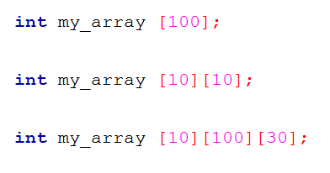
Types of Array
One dimensional Array
Multi dimensional Array

Slide 4
One Dimensional Array
In C, a one dimensional array is a list of variables that are all of the same type and are accessed through a common name.
An individual variable in the array is called an array element.
It is useful to handle groups of related data.

Slide 5
One Dimensional Array….
General form-
type is a valid C data type.
var_name is the name of the array
size specifies the number of elements in the array
type var_name[size]
Type
Array name
Size – can hold 100 elements

Slide 6
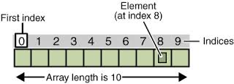

One Dimensional Array….
An array element is accessed by indexing the array using the number of the element.
In C, all arrays begin at zero.

Slide 7
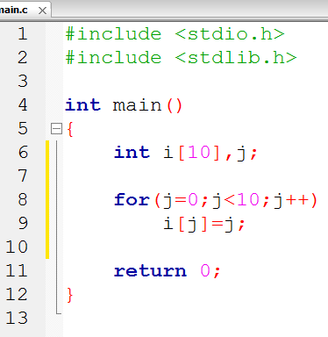
One Dimensional Array….
Array - 1 (assign value)

Slide 8
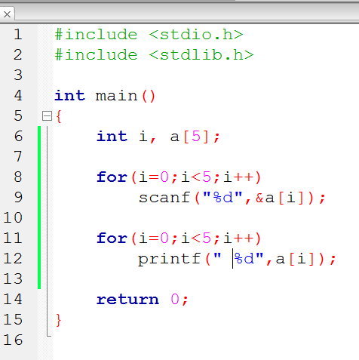
Array…. Input from KB
Array-2 (Input from KB)
Single element access

Slide 9


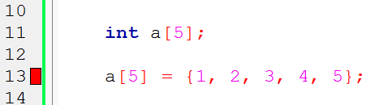
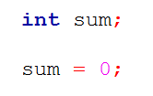
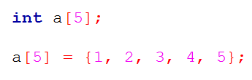
Initialize Arrays
Variable Initialization
Array Initialization

Slide 10
Be aware!
Bounds checking
Assign one entire to another
Single element access

Slide 11
Assignment 1
Write a C program that will find the largest number among 10 user given numbers of any data types.
Assignment 2
Find out the output of the following program.
#include<stdio.h>
int main(){
int a[8]={5,2,3,1,4,5,2},i;
for(i=0;i<8;i++){
if(a[i]%2==1)
printf(“%d ”,i);
}
return 0;
}

Slide 12
Array Dimension
One dimensional array consists of only one dimension(row). E.g. int a[10];
Multidimensional array consists of more than one dimension.
E.g: int a[5][2];
int a[5][3][2];

Slide 13
Two – Dimensional Array
A two dimensional array is an array of one dimensional arrays and most easily thought of in row, column format.
Syntax: data_type name[row][column];

Slide 14
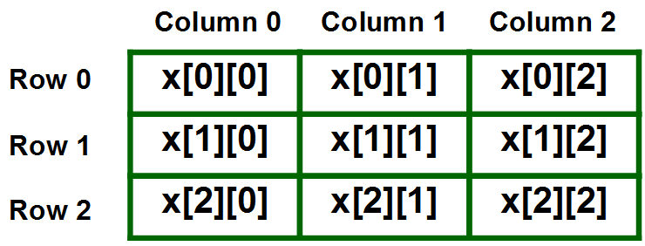
int x[3][3];

Slide 15
2-D Array Initialization
Like 1-D array
Another approach (Row wise)
int x[3][4] = {0, 1 ,2 ,3 ,4 , 5 , 6 , 7 , 8 , 9 , 10 , 11}
int x[3][4] = {{0,1,2,3}, {4,5,6,7}, {8,9,10,11}};

Slide 16
Examples
Array-3 (Find biggest number)
Array-4 (Sorting)

